Slide 1
k-Nearest Neighbor (kNN)
Syed Shayan Ali Shah

Slide 2
Outline
k-Nearest Neighbor (kNN) Algrorithm Overview
Algorithm Formulation
Distance Metrics
Choice of k
Algorithm Convergence
Storage, Time Complexity Analysis
Fast kNN
The Curse of Dimensionality

Slide 3
Supervised Learning
Classification Algorithms or Methods
Predicting a categorical output is called classification
Bayesian Methods
Frequency Table
Decision Trees
Covariance Matrix
Linear Dis. Analysis
Logistic Regression
Classification
Similarity Function
K Nearest Neighbor
Neural Network
Others
Support Vector Machine

Slide 4








k-Nearest Neighbor (kNN) Algorithm
1-Nearest Neighbor:
Simplest ML Classifier
Idea: Use the label of the closest known point
Label should be red.
Generalization:
Determine the label of k nearest neighbors and assign the most frequent label
Label should be red
Label should be blue
k=3
k=7

Slide 5
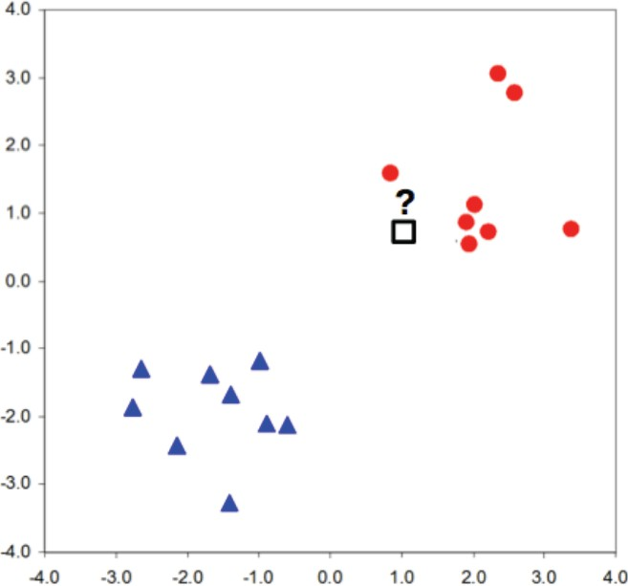
k-Nearest Neighbor (kNN) Algorithm
Idea:
- Two classes, two features
- We want to assign label to unknown data point?
?
- Label should be red.

Slide 6
k-Nearest Neighbor (kNN) Algorithm
Idea:
We have similar labels for similar features.
We classify new test point using similar training data points.
Algorithm overview:
Given some new test point x for which we need to predict the class y.
Find most similar data-points in the training data.
Classify x “like” these most similar data points.
Questions:
How do we determine the similarity?
How many similar training data points to consider?
How to resolve inconsistencies among the training data points?

Slide 7
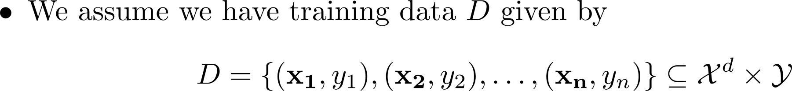
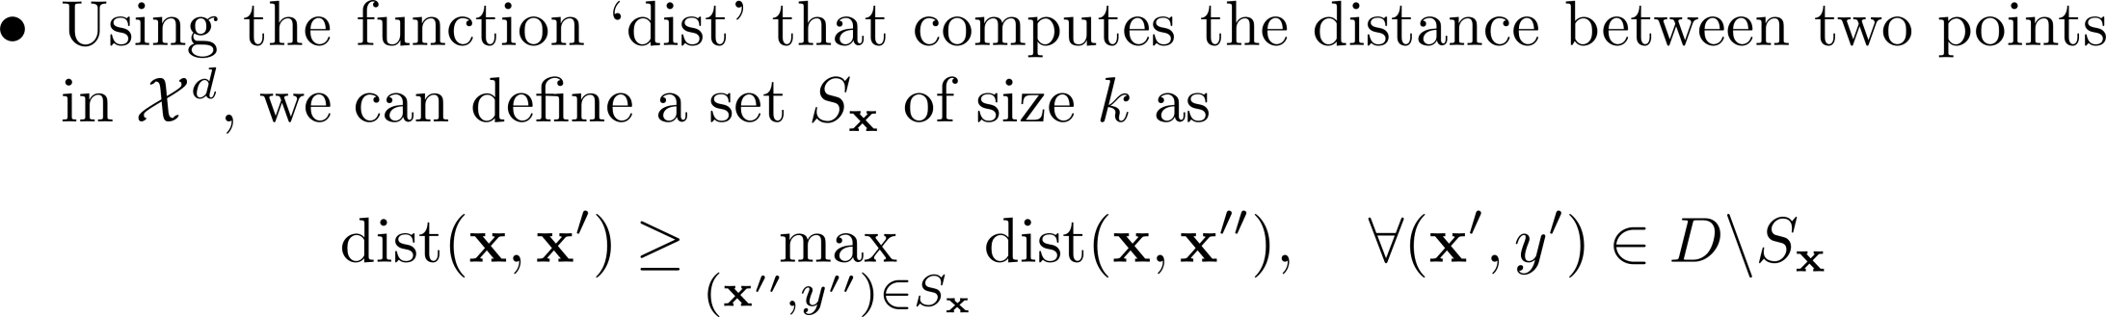
k-Nearest Neighbor (kNN) Algorithm
Formal Definition:
Interpretation:

Slide 8
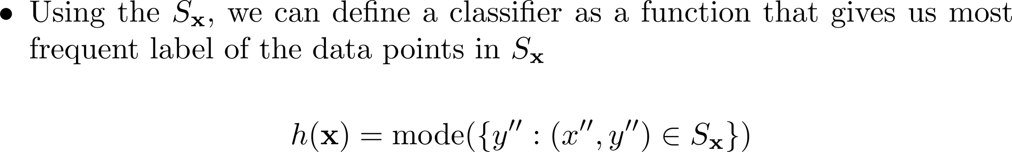
k-Nearest Neighbor (kNN) Algorithm
Formal Definition:

Slide 9
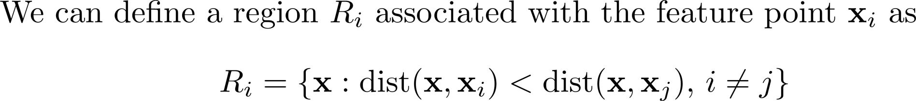
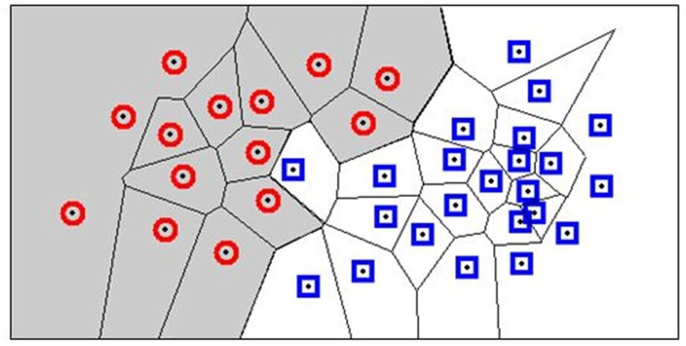
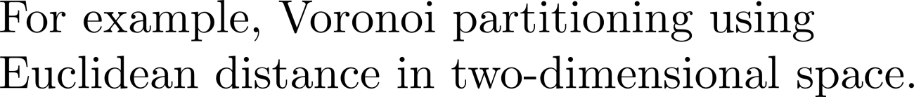
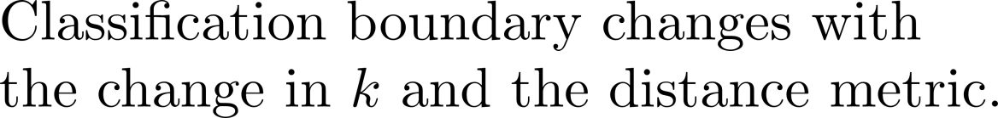
k-Nearest Neighbor (kNN) Algorithm
Decision Boundary:

Slide 10
k-Nearest Neighbor (kNN) Algorithm
Characteristics of kNN:
No assumptions about the distribution of the data
Non-parametric algorithm
  No parameters
Hyper-Parameters
  k (number of neighbors)
  Distance metric (to quantify similarity)
- Complexity (both time and storage) of prediction increases with the size of training data.

Slide 11
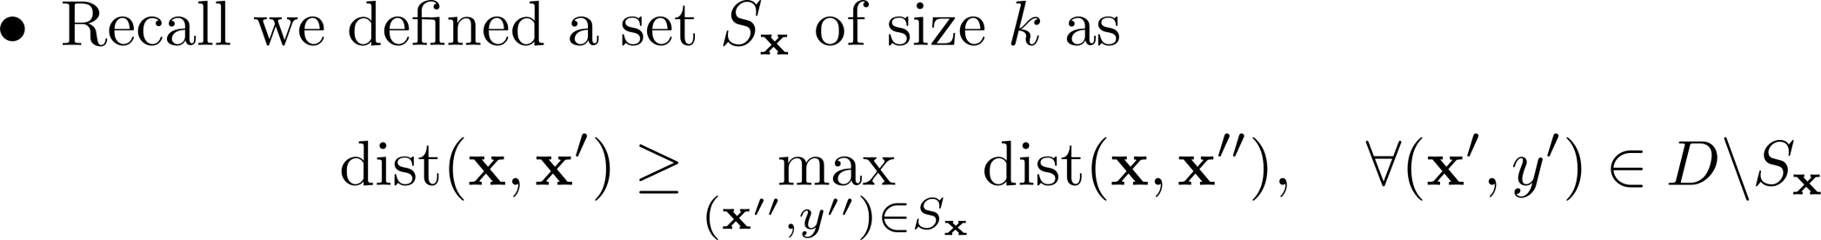
k-Nearest Neighbor (kNN) Algorithm
We need to define distance metric to find the set of k nearest neighbors, S_{x}

Slide 12
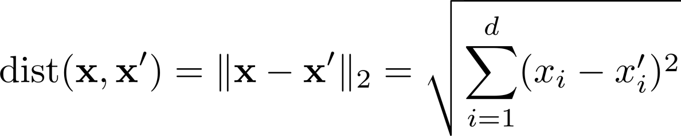

k-Nearest Neighbor (kNN) Algorithm
Distance Metric:

Slide 13
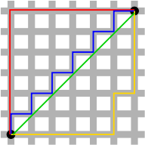
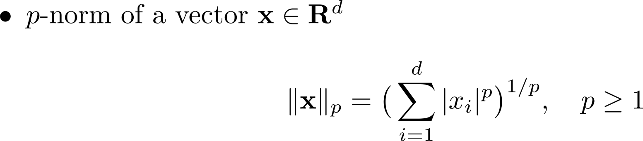



k-Nearest Neighbor (kNN) Algorithm
Norm of a vector
Properties of Norm

Slide 14

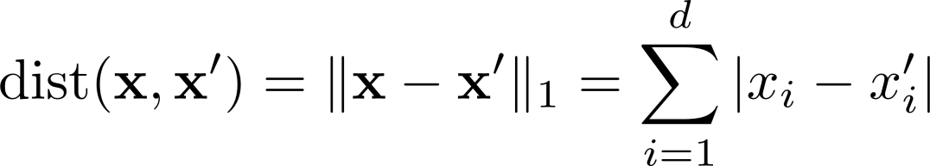


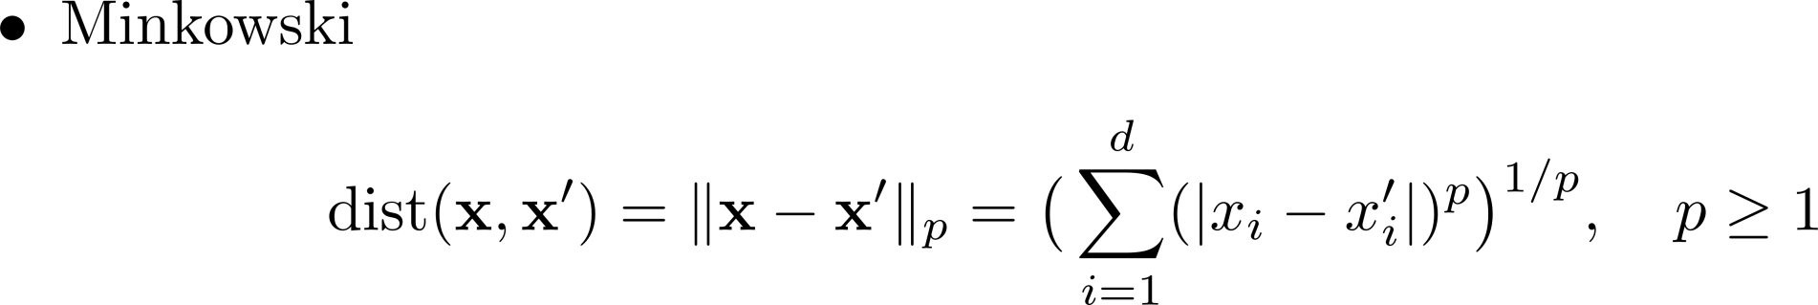


k-Nearest Neighbor (kNN) Algorithm
Distance Metric:

Slide 15
k-Nearest Neighbor (kNN) Algorithm
Distance Metric:
Properties of Distance Metrics:

Slide 16
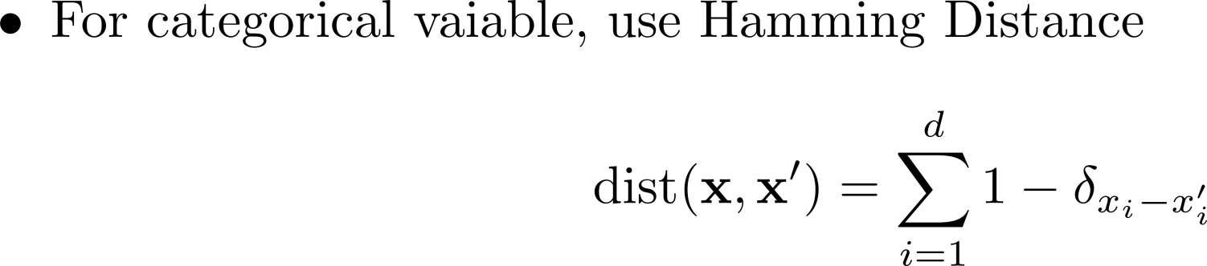
k-Nearest Neighbor (kNN) Algorithm
Distance Metric:

Slide 17
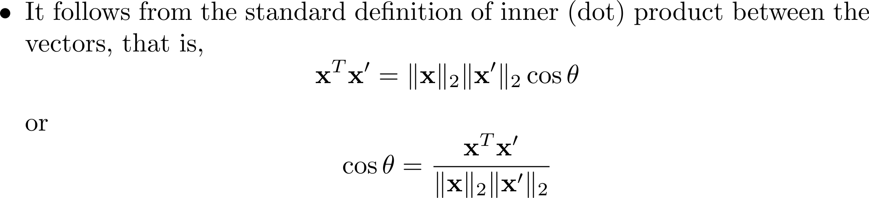
k-Nearest Neighbor (kNN) Algorithm
Cosine Distance
What is the range of values of angular distance and what is the interpretation of these values?

Slide 18
k-Nearest Neighbor (kNN) Algorithm
Practical issues in computing distance:
Mismatch in the values of data
  Issue: Distance metric is mapping from d-dimensional space to a scaler. The values should be of the same order along each dimension.
  Solution: Data Normalization

Slide 19
Outline
k-Nearest Neighbor (kNN) Algroithm Overview
Algorithm Formulation
Distance Metrics
Choice of k
Algorithm Convergence
Storage, Time Complexity Analysis
Fast kNN
The Curse of Dimensionality

Slide 20
k-Nearest Neighbor (kNN) Algorithm
Choice of k:
- k=1
Sensitive to noise High variance
Increasing k makes algorithm less sensitive to noise
- k=n
Decreasing k enables capturing finer structure of space
Idea: Pick k not too large, but not too small (depends on data) How?

Slide 21
k-Nearest Neighbor (kNN) Algorithm
Choice of k:
Learn the best hyper-parameter, k using the data.
Split data into training and validation.
Start from k=1 and keep iterating by carrying out (5 or 10, for example) cross-validation and computing the loss on the validation data using the training data.
Choose the value for k that minimizes validation loss.
This is the only learning required for kNN.

Slide 22
Outline
k-Nearest Neighbor (kNN) Algroithm Overview
Algorithm Formulation
Distance Metrics
Choice of k
Algorithm Convergence
Storage, Time Complexity Analysis
Fast kNN
The Curse of Dimensionality

Slide 23
k-Nearest Neighbor (kNN) Algorithm
Error Convergence:

Slide 24
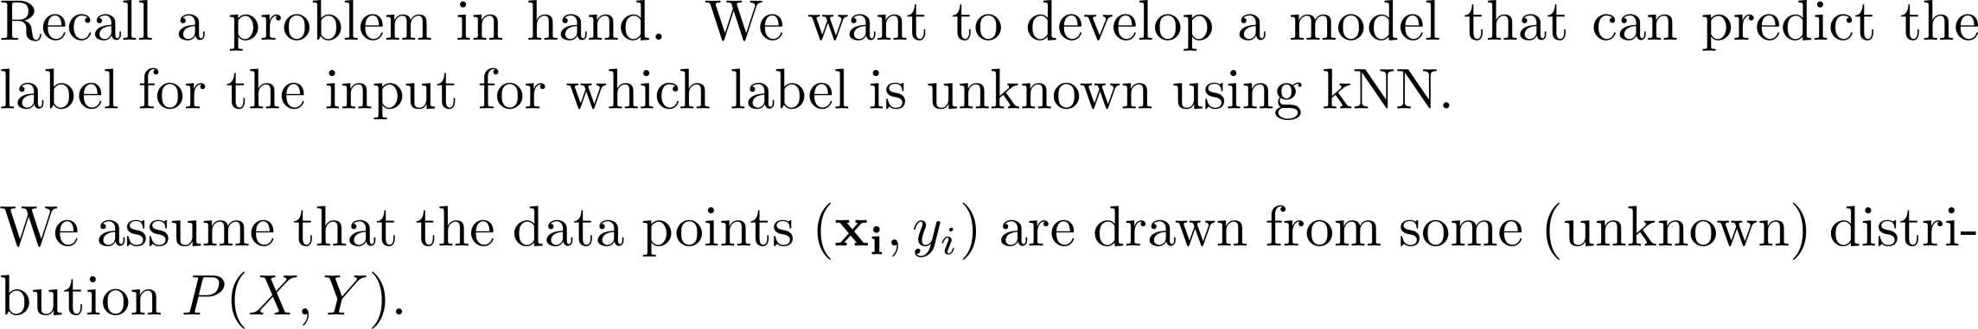
k-Nearest Neighbor (kNN) Algorithm
Learning Problem

Slide 25

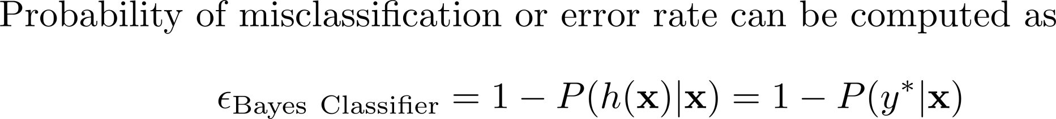
k-Nearest Neighbor (kNN) Algorithm
Bayes Optimal Classifier
Error Rate:

Slide 26
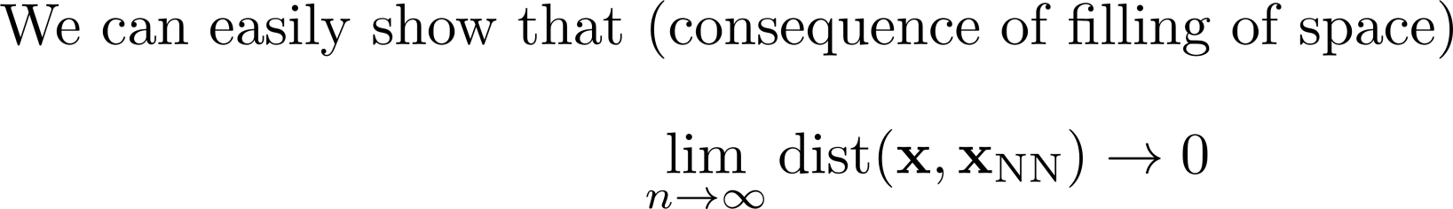
k-Nearest Neighbor (kNN) Algorithm
Error Convergence:
Error Rate:
Reference: Cover, Thomas, and, Hart, Peter. Nearest neighbor pattern classification[J]. IEEE Transactions on Information Theory, 1967, 13(1): 21-27

Slide 27


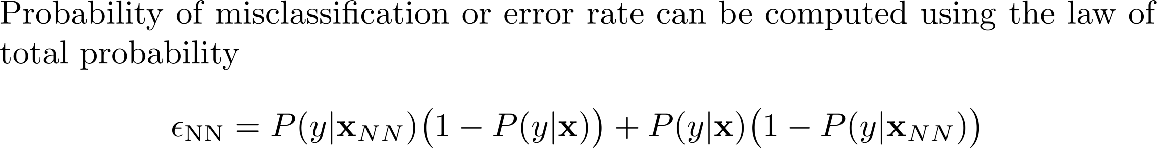
k-Nearest Neighbor (kNN) Algorithm
Error Convergence:
Error Rate:

Slide 28
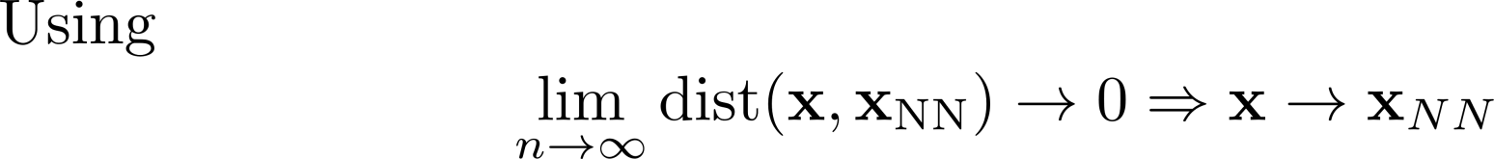
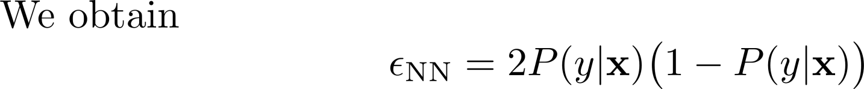



k-Nearest Neighbor (kNN) Algorithm
Error Convergence:
Bound on Error Rate:

Slide 29
Outline
k-Nearest Neighbor (kNN) Algroithm Overview
Algorithm Formulation
Distance Metrics
Choice of k
Algorithm Convergence
Storage, Time Complexity Analysis
Fast kNN
The Curse of Dimensionality

Slide 30
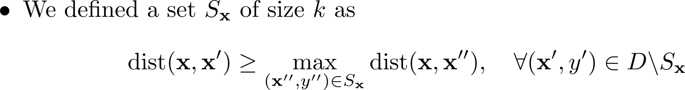
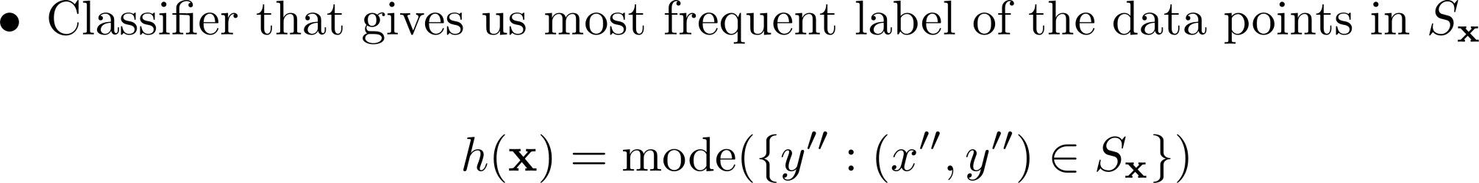
k-Nearest Neighbor (kNN) Algorithm
Algorithm Computational and Storage Complexity: Input/Output:
Steps:

Slide 31



k-Nearest Neighbor (kNN) Algorithm
Algorithm:
Steps:
Computational Complexity
1. Find distance between given test point and feature vector of every point in D.
2. Find k points in D closest to the given test point vector to form a set S_{X}.
3. Find the most frequent label in the set S_{x} and assign it to the test point.
Computational Complexity: Space Complexity:

Slide 32
Outline
k-Nearest Neighbor (kNN) Algroithm Overview
Algorithm Formulation
Distance Metrics
Choice of k
Algorithm Convergence
Storage, Time Complexity Analysis
Fast kNN
The Curse of Dimensionality

Slide 33
k-Nearest Neighbor (kNN) Algorithm
Fast kNN:
kNN Computational complexity: O(nd)
How to make it faster?
  Dimensionality Reduction
    Feature Selection (to be covered later)
    PCA (to be covered later)
  Use efficient method to find nearest neighbors
    KD Tree

Slide 34
k-Nearest Neighbor (kNN) Algorithm
K-D Tree:
k-Dimensional tree
  Extended version of binary search tree in higher dimension
Pick the splitting dimension
  Randomly
  Large variance dimension
Pick the middle value of the feature along the selected dimension after sorting along that dimension.
Use this value as the root node and construct a binary tree and keep going.

Slide 35


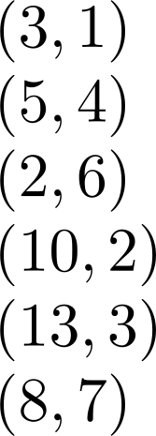






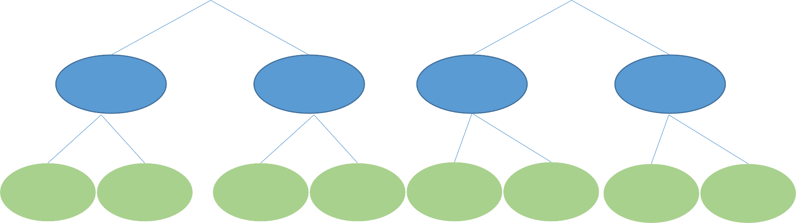
k-Nearest Neighbor (kNN) Algorithm
K-D Tree:
Example:
Splitting dimension

Slide 36


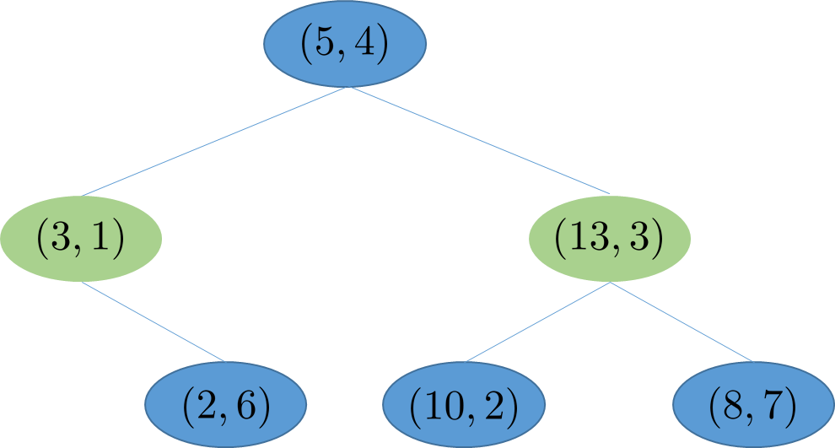




k-Nearest Neighbor (kNN) Algorithm
K-D Tree: Example:

Slide 37


k-Nearest Neighbor (kNN) Algorithm
K-D Tree:
Connection with kNN: Finding nearest neighbor
Issue: May miss neighbors! Trick to handle this.

Slide 38
k-Nearest Neighbor (kNN) Algorithm
K-D Tree - Summary:
Enables significant reduction in the time complexity to support nearest neighbor algorithm.
  Search to O(logn).
Trade-offs:
  Computational overhead to construct a tree O(n logn).
  Space complexity: O(n).
  May miss neighbors.
  Performance is degraded with the increase in the dimension of future space (Curse of Dimensionality).

Slide 39
Outline
k-Nearest Neighbor (kNN) Algroithm Overview
Algorithm Formulation
Distance Metrics
Choice of k
Algorithm Convergence
Storage, Time Complexity Analysis
Fast kNN
The Curse of Dimensionality

Slide 40
k-Nearest Neighbor (kNN) Algorithm
The Curse of Dimensionality:
Refers to the problems or phenomena associated with classifying, analyzing and organizing the data in high-dimensional spaces that do not arise in low-dimensional settings.
For high-dimensional datasets, the size of data space is huge.
In other words, the size of the feature space grows exponentially
with the number of dimensions (d) of the data sets.
To ensure the points stay close to each other, the size (n) of the data set must also have exponential growth. That means, we need a very large dataset to maintain the density of points in the high dimensional space.

Slide 41
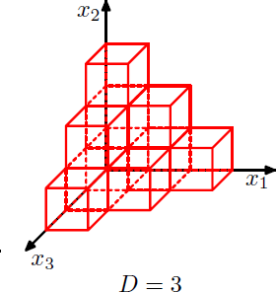
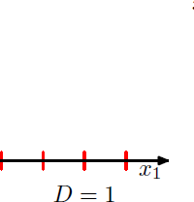
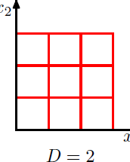
k-Nearest Neighbor (kNN) Algorithm
The Curse of Dimensionality:
- For high-dimensional datasets, the size of data space is huge.
For an exponentially large number of cells, we need an exponentially large amount of training data to ensure that the cells are not empty.
Ref: CB

Slide 42
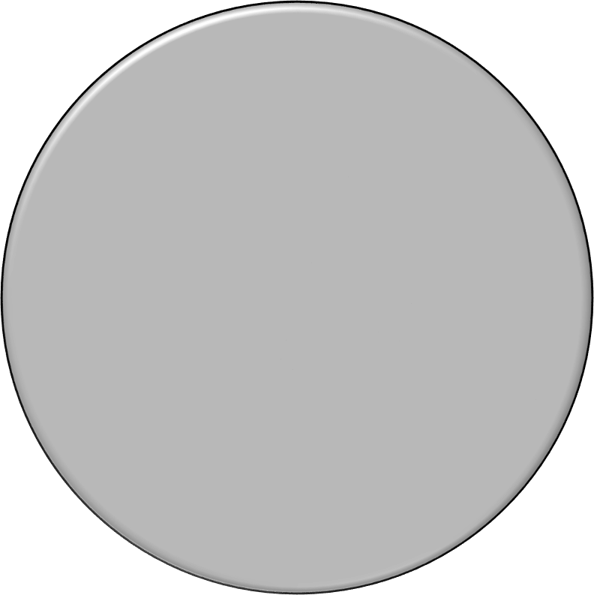


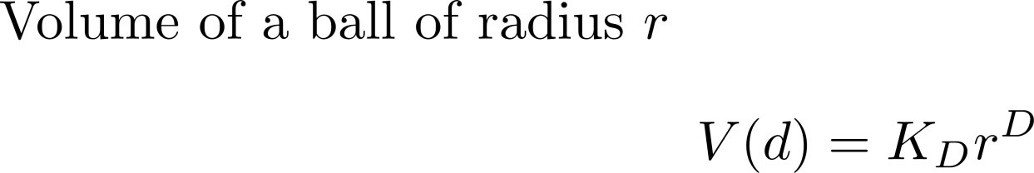
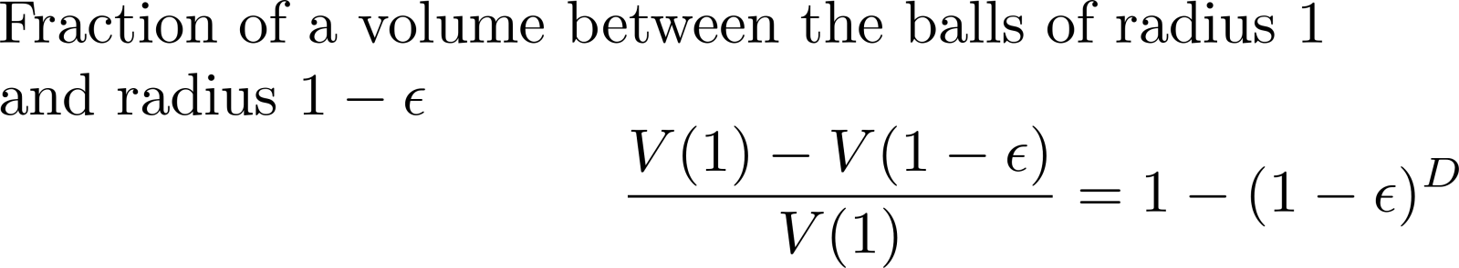
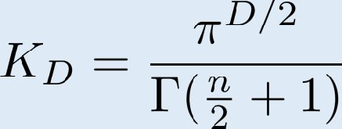
k-Nearest Neighbor (kNN) Algorithm
The Curse of Dimensionality:

Slide 43

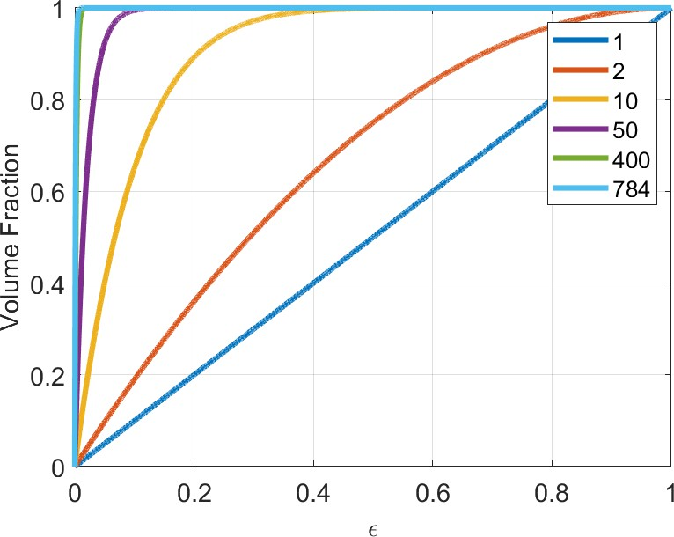
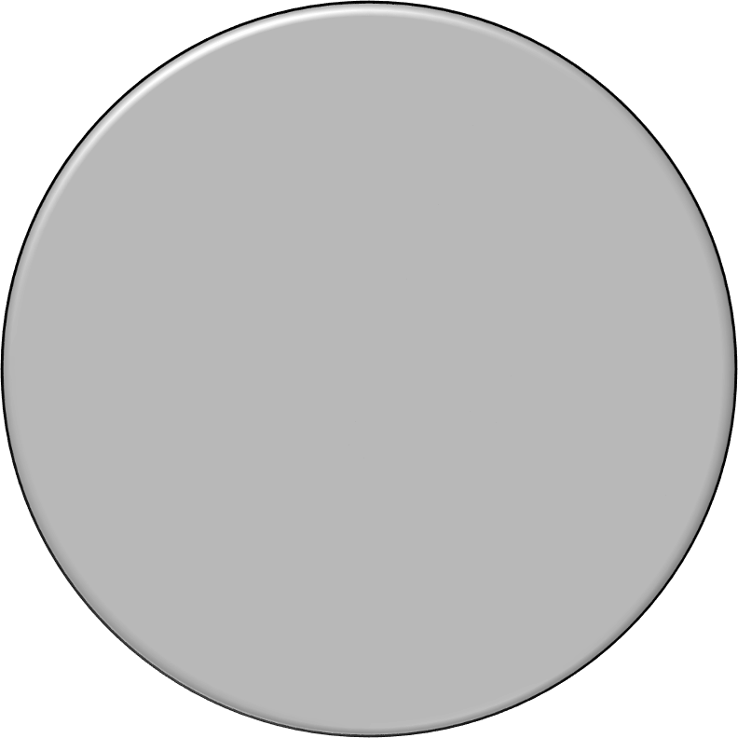

k-Nearest Neighbor (kNN) Algorithm
The Curse of Dimensionality:

Slide 44
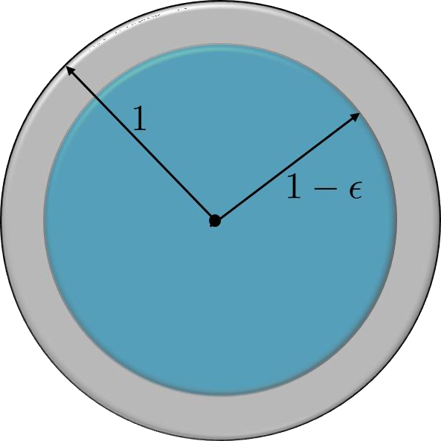




k-Nearest Neighbor (kNN) Algorithm
The Curse of Dimensionality (Another viewpoint):
D = 1 | 2 | 10 | 50 | 400 | 784
0.1 | 0.19 | 0.65 | 0.995 | 1.000 | 1.000
0.9 | 0.81 | 0.35 | 0.005 | 0.000 | 0.000

Slide 45

k-Nearest Neighbor (kNN) Algorithm
The Curse of Dimensionality (Another viewpoint):
D = 1 | 2 | 10 | 50 | 400 | 784
0.01 | 0.02 | 0.096 | 0.395 | 0.982 | 0.999
0.99 | 0.98 | 0.904 | 0.605 | 0.018 | 0.0004

Slide 46
k-Nearest Neighbor (kNN) Algorithm
The Curse of Dimensionality:
Connection with kNN:
With the increase in the number of features or number of dimensions
of the feature space, data-points are never near to one another.
kNN algorithm carries out predictions about the test point assuming we have data-points near to the test point that are similar to the test point.
As we do not have neighbors in the high dimensional space, kNN becomes vulnerable and sensitive to the Curse of Dimensionality.

Slide 47
k-Nearest Neighbor (kNN) Algorithm
The Curse of Dimensionality: Why does kNN work?
Two related explanations;
Real-world data in the higher dimensional space is confined to a region with effective lower dimensionality.
  Dimensionality Reduction (to be covered later in the course)
Real-world data exhibits smoothness that enables us to make
predictions exploiting interpolation techniques.
For example,
  Data along a line or a plane in higher dimensional space
  detection of orientation of object in an image; data lies on effectively 1 dimensional manifold in probably 1million dimensional space.
  Face recognition in an image (50 or 71 features).
  Spam filter

